Slide 1
E-PROJECT OF THE SEMESTER (Gracious Garments)
Assalam u Alaikum
In the name of Allah, we made e-project of Gracious Garments which task you give us.
We are four members groups which try to make what’s you wants and insert our full effort to make it professional.
Ibad Khalid
Sohaib
Ikhlas Bano
Ayesha Rashid
Our co-ordinator and faculty we learn and get knowledge which they tech us.
Miss Sidrah Saleem
Sir Abbas Manzoor

Slide 2
YOUR NEEDS AND REQUIRMENTS Gracious Garments
We also keep care to fulfill your requirements and try to make sure to satisfied you and make our work proper and professional.
Following of these requirements and conditions are given yours.
The Home page create proper section and suitable logo.
Home page contain details and use suitable images also.
Our project contains brief introduction and proper instructions about all brands and all various garments are available, location of shops and any other information required.
There should be a contact page and also keep form validation and API location in our project.
All over requirements try to fulfill and also try to make sure to keep your likes our importance.

Slide 3
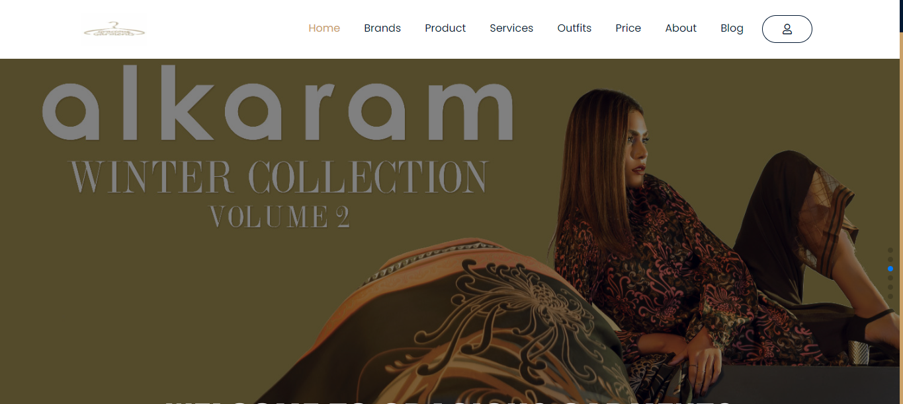
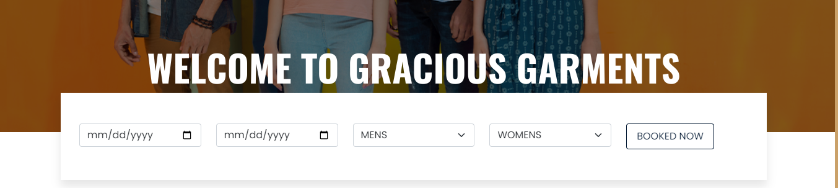
SOME INFORMATION ABOUT OUR PROJECT Gracious Garments
HOME PAGE
Our brand home page made by
Bootstrap 5 and we try to make it
Simple & Beautiful.
Booking form also
Realized that we make
Our page professionally and
Attractive.

Slide 4
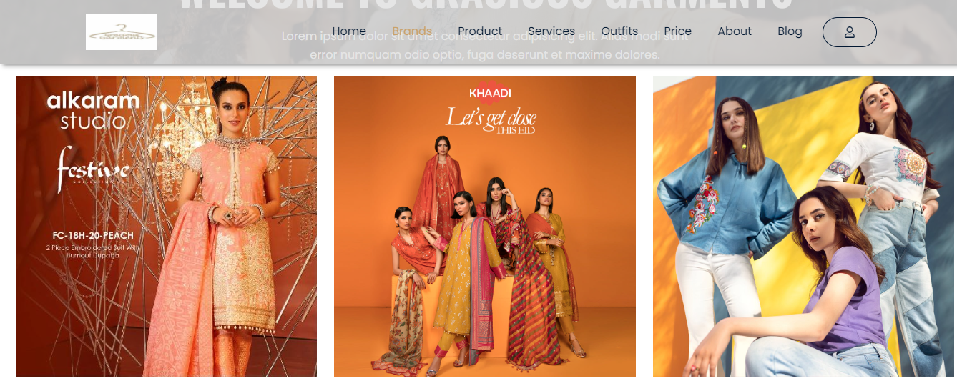
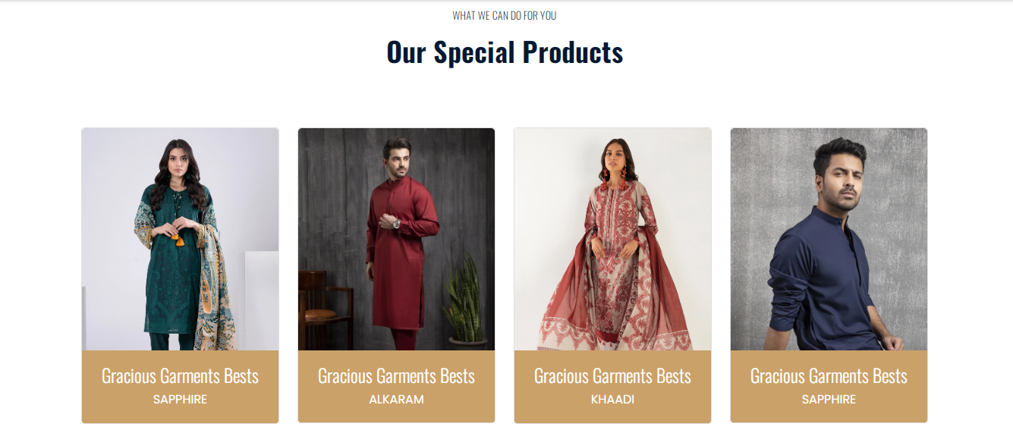
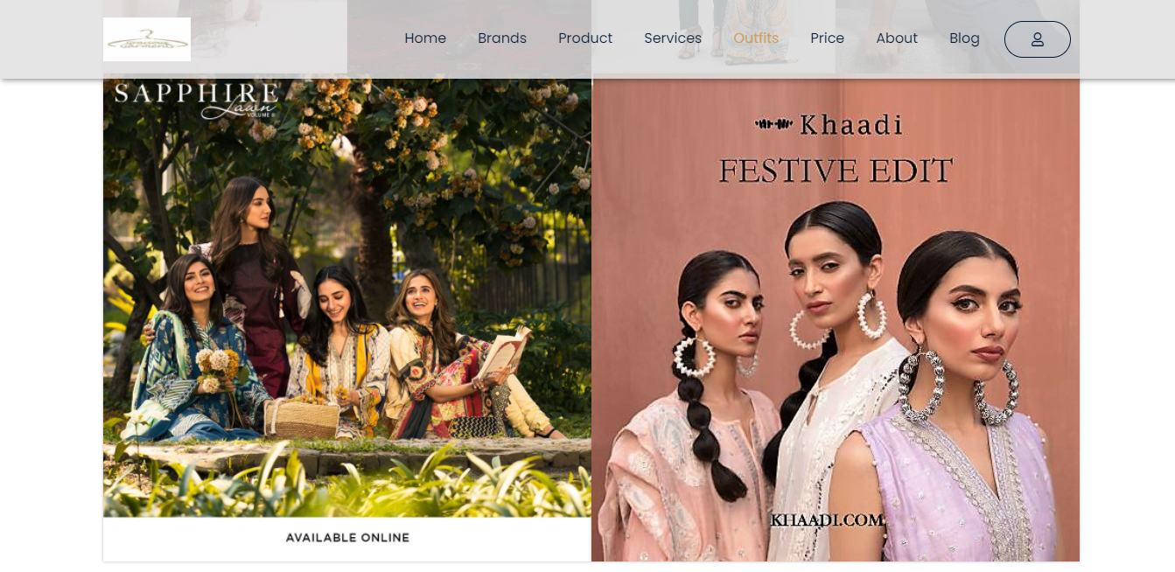

Slide 5
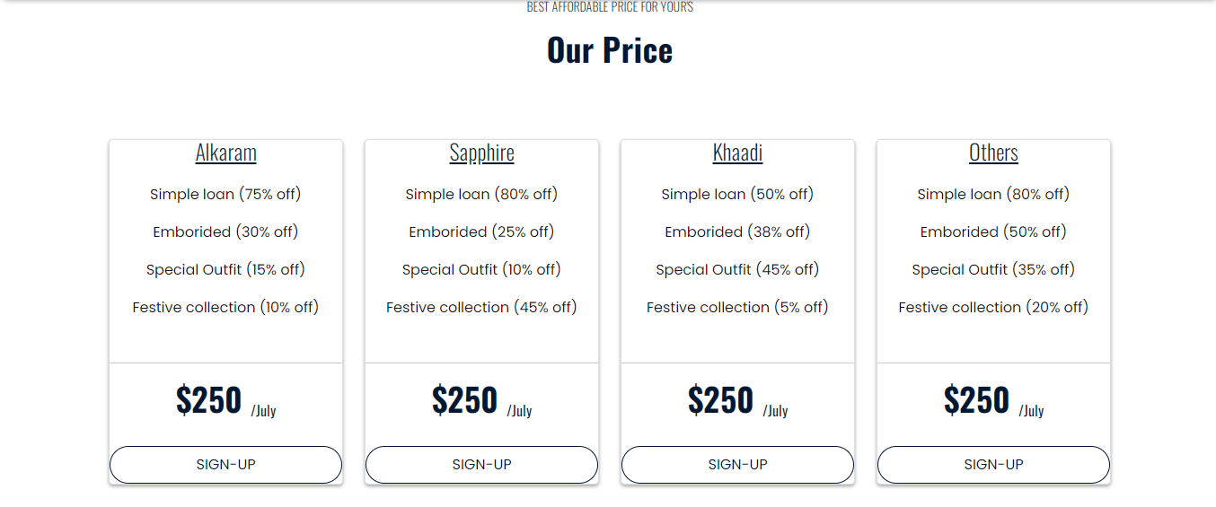
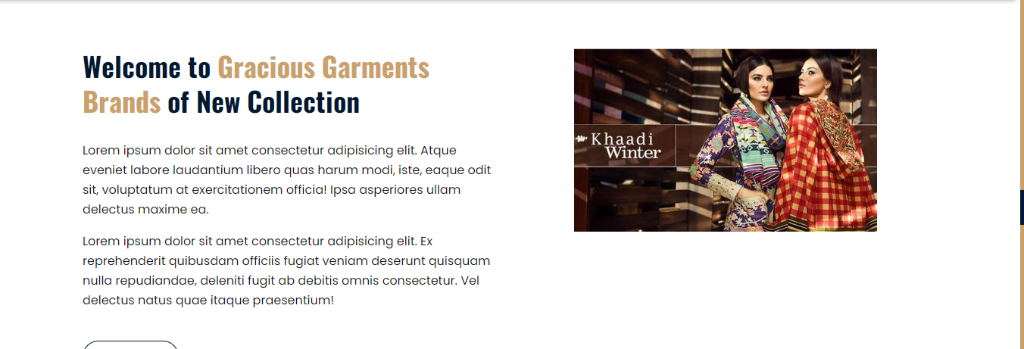
Our Pricing section
We keep pricing
Section to our home
Page section, these cards
Make help to our visitors
For pricing.
Our About Section
About section
Make help to our visitors
To know about our brands.

Slide 6

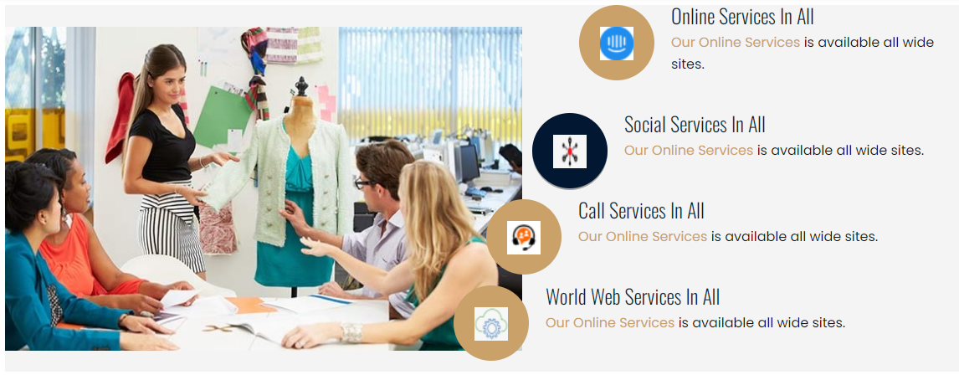
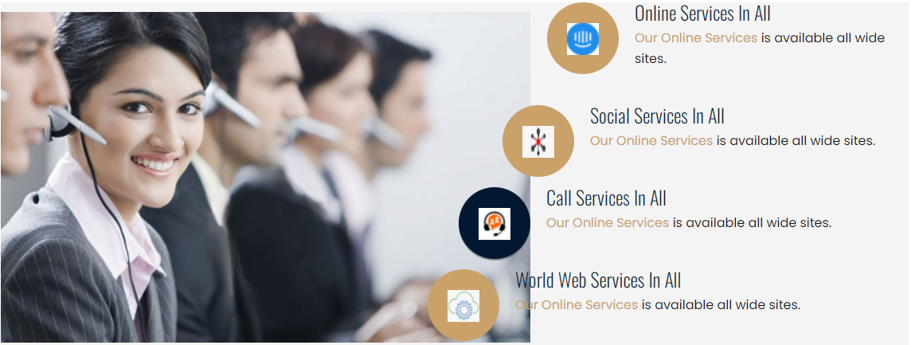
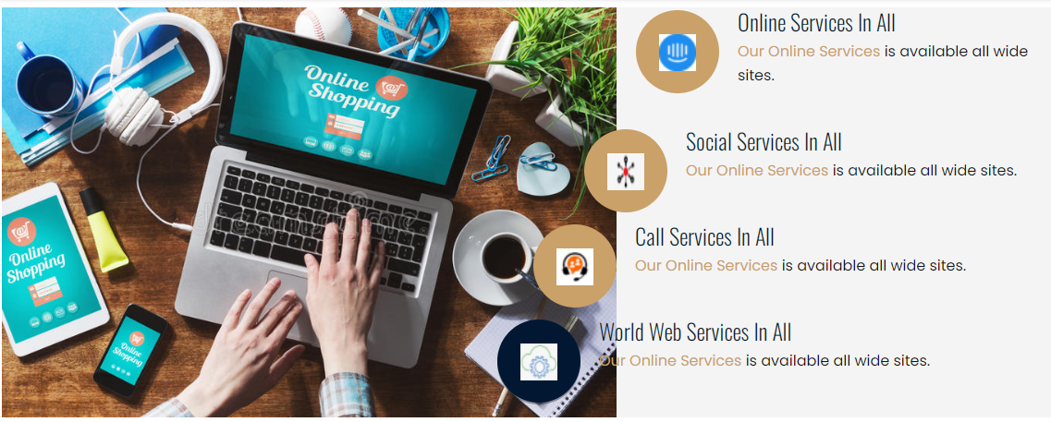
O
U
R
S
E
R
V
I
C
E
S
S
E
C
T
I
O
N

Slide 7
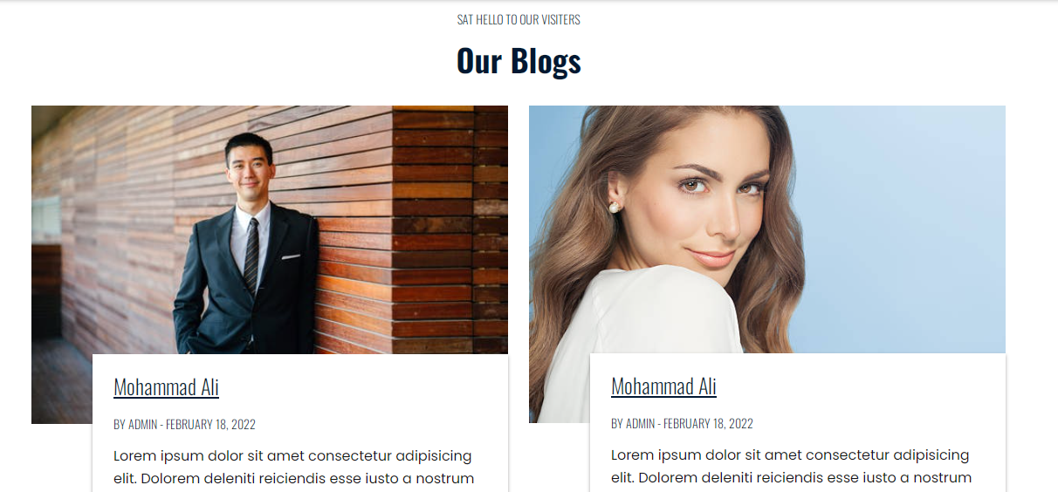
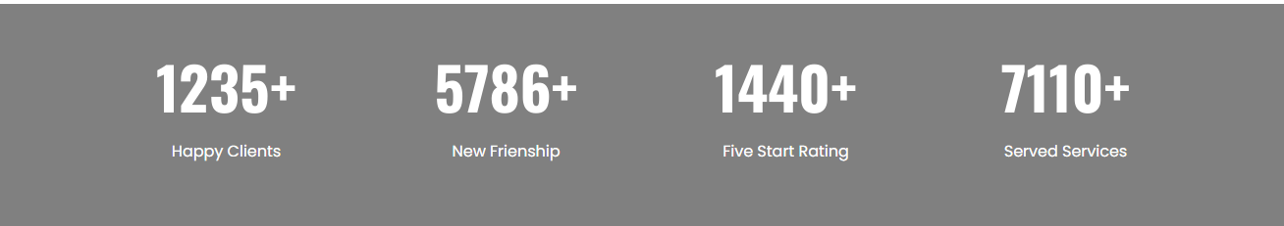
We also make a rating slide in our web page because of it our
Site look cool and professional.

Slide 8

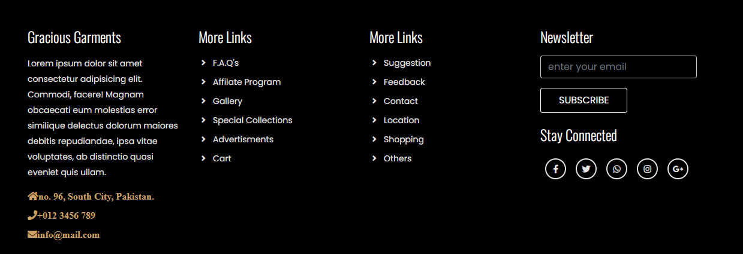
We make a brands logo slider
Before our footer to make our page
Beautiful and attractive.

Slide 9
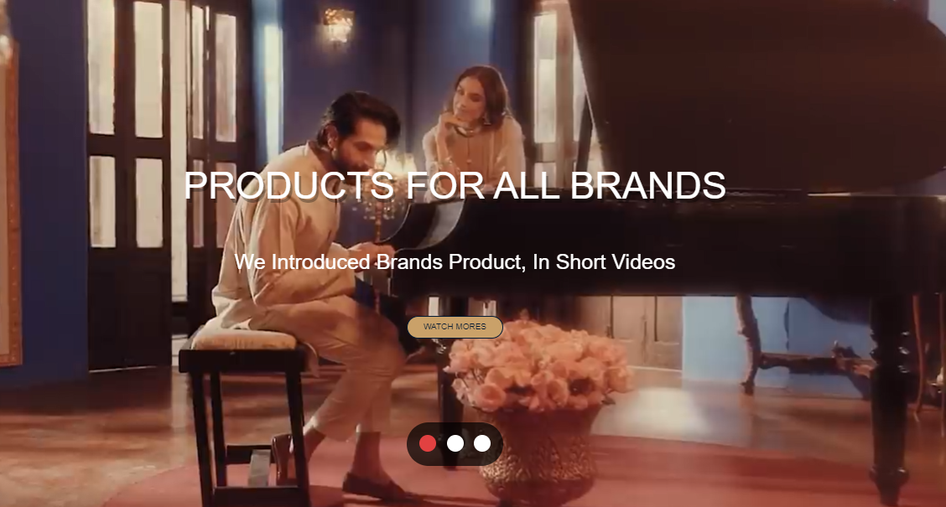
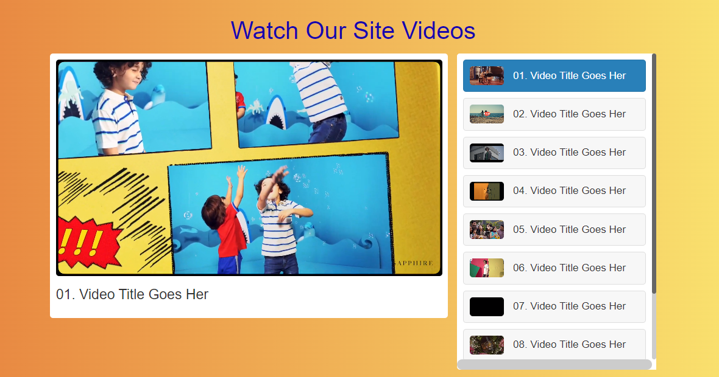

Slide 10
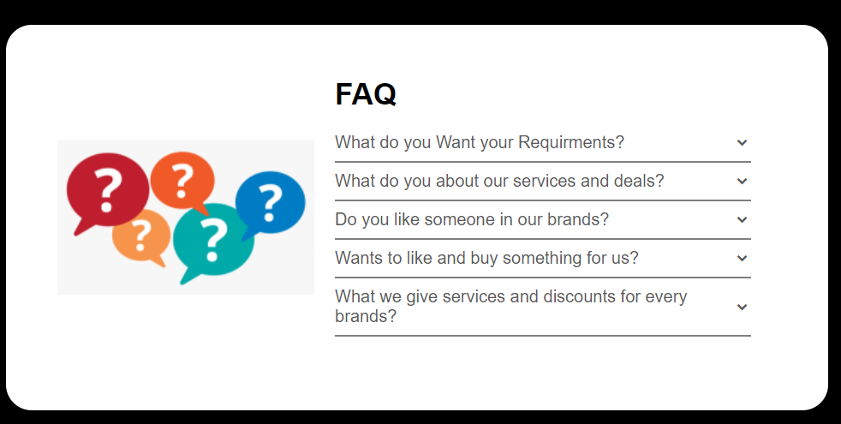
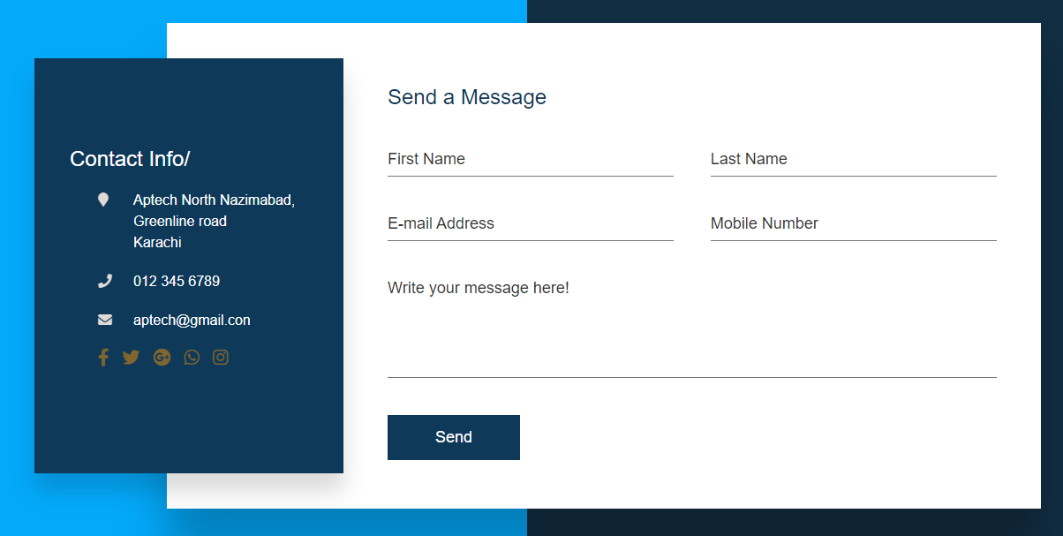

Slide 11
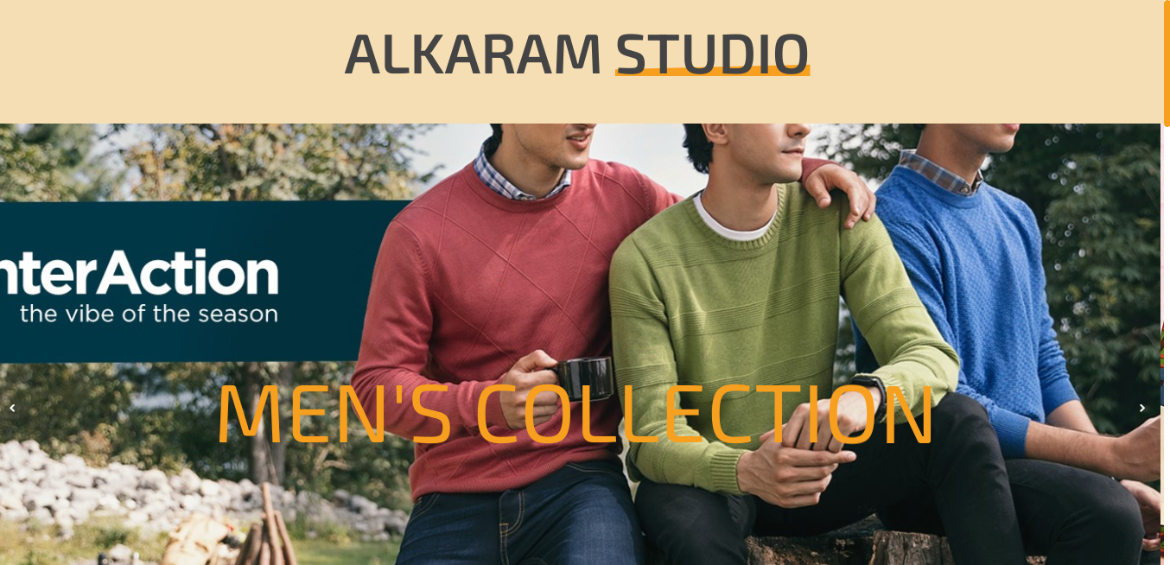
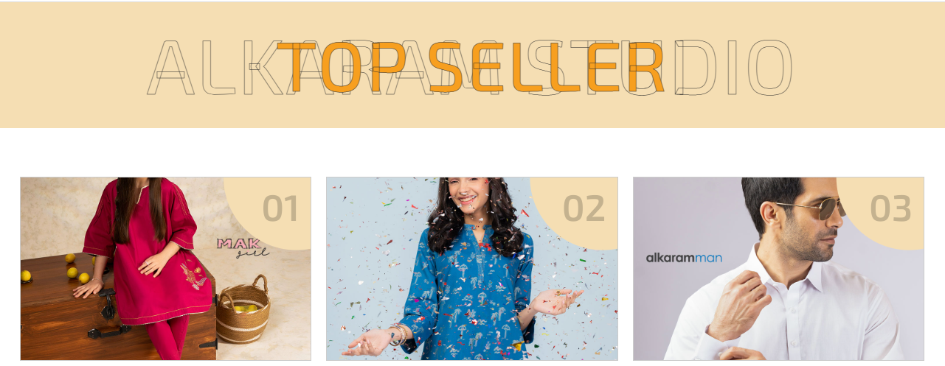
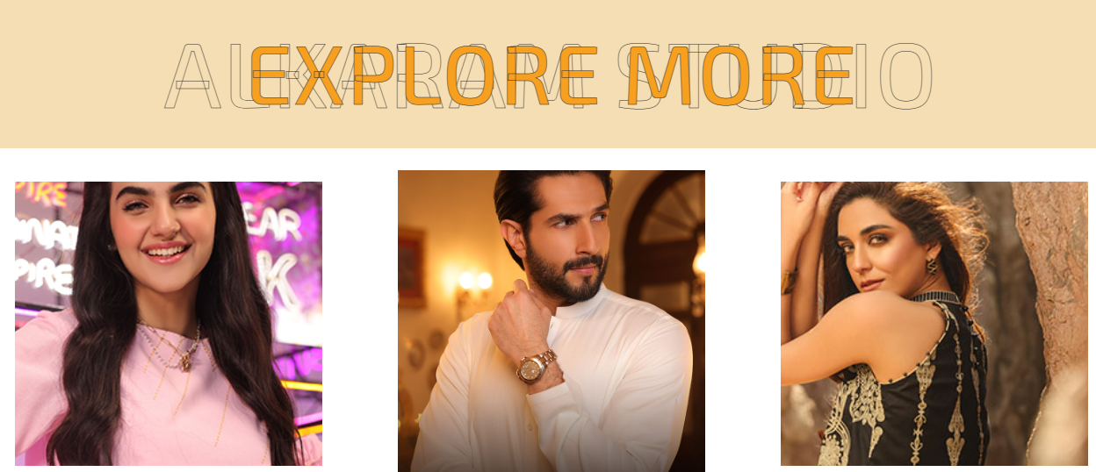
GRACIOUS GARMENTS ALKARAM STUDIO( 1st Brand of our site)

Slide 12
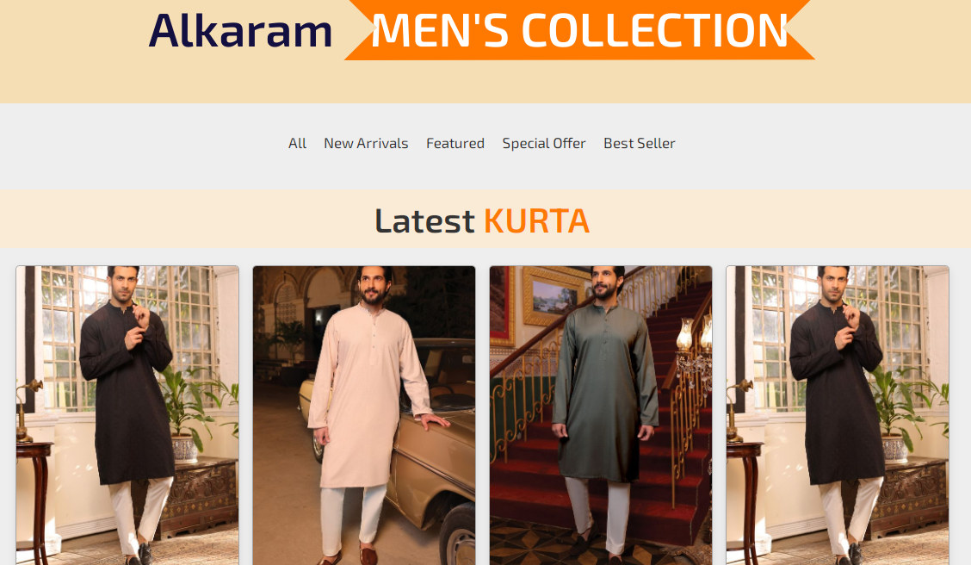
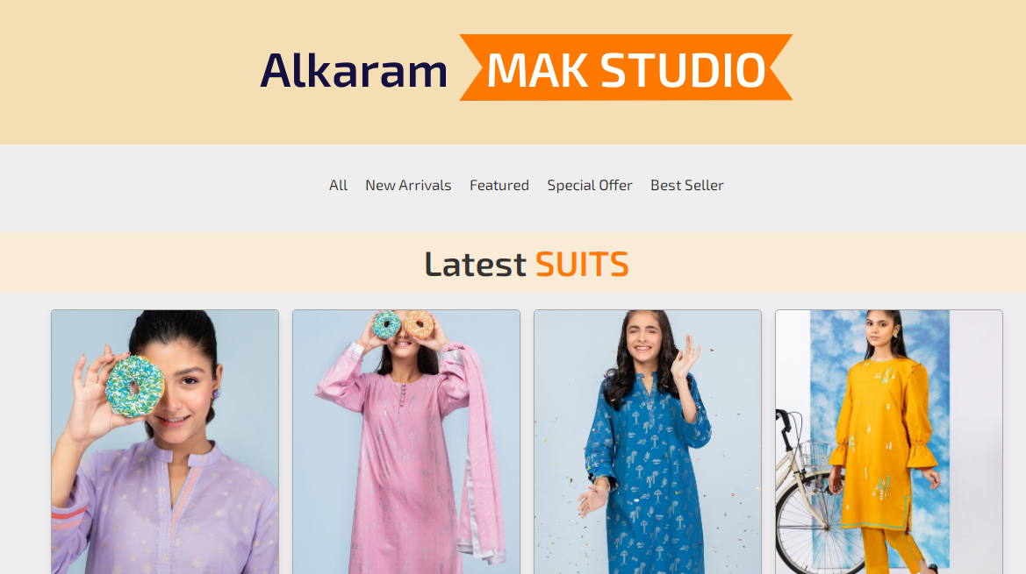
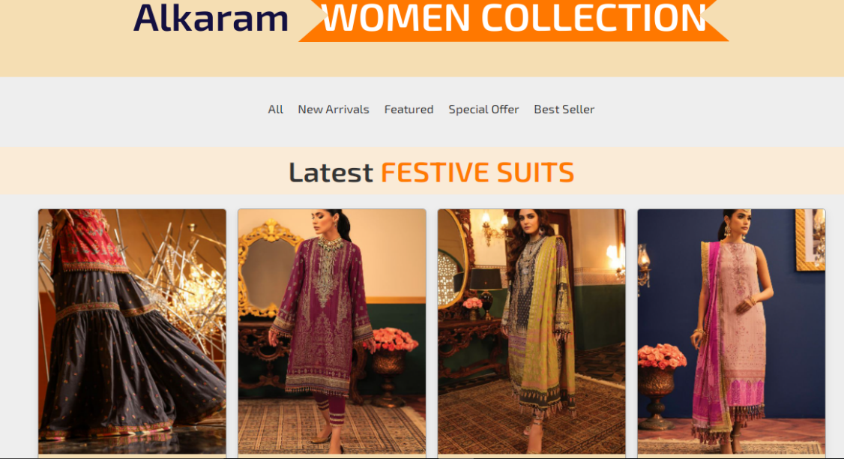
Alkaram Men Collection
Alkaram Mak Studio Cards
Alkaram Women Collection

Slide 13

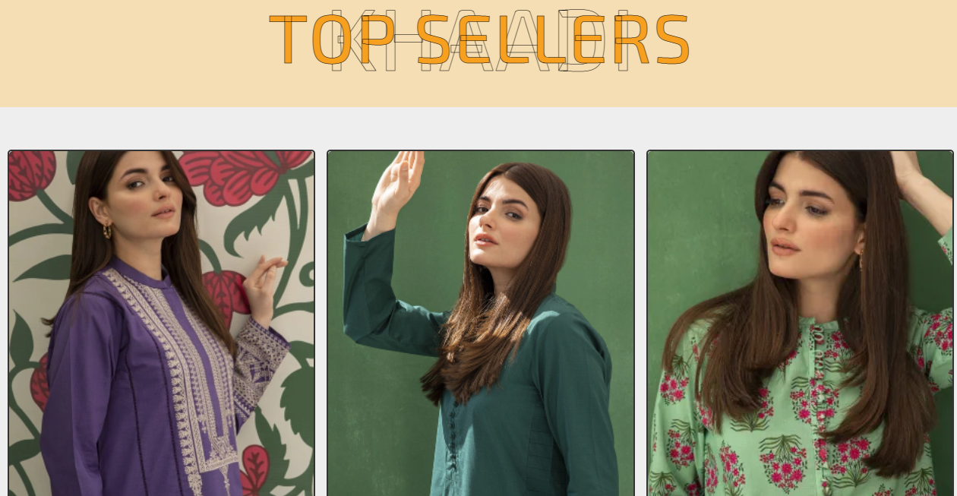
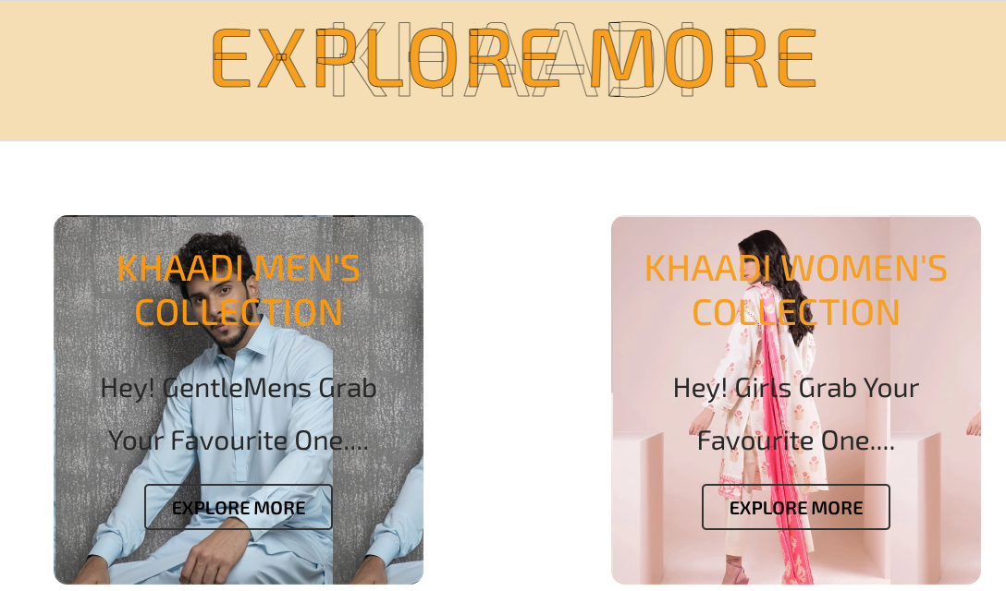
GRACIOUS GARMENTS KHAADI( 2nd Brand of our site)

Slide 14
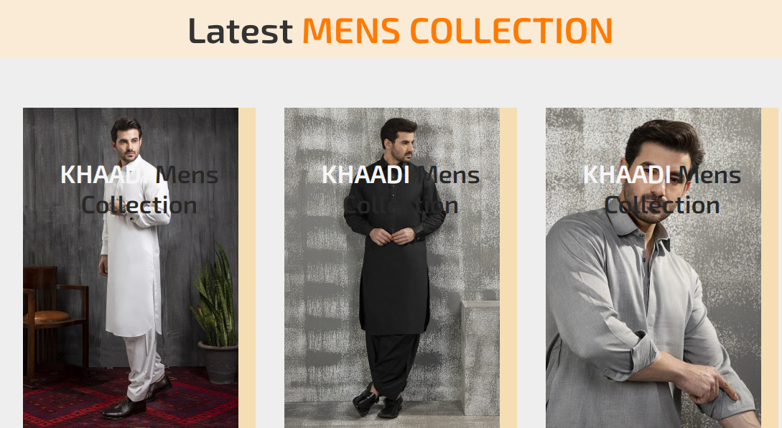
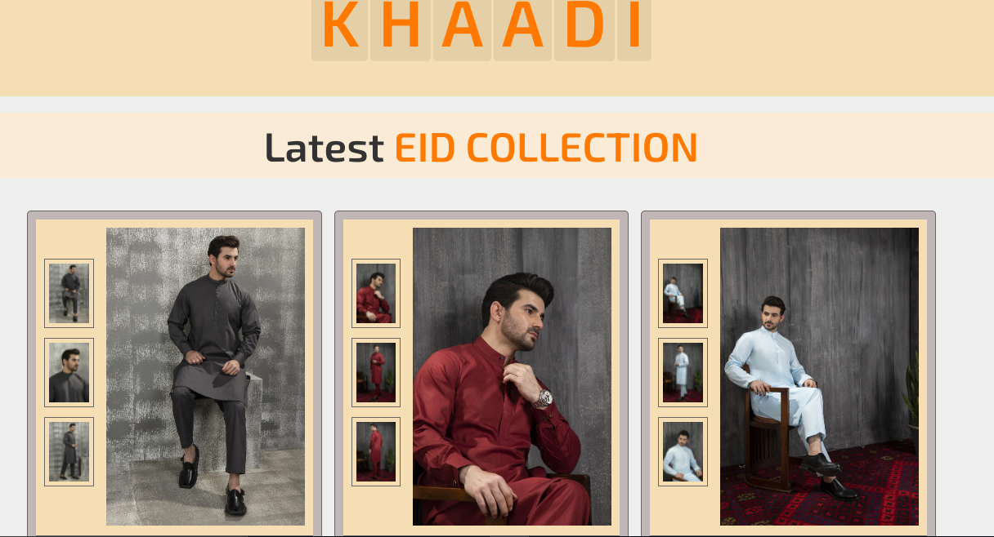
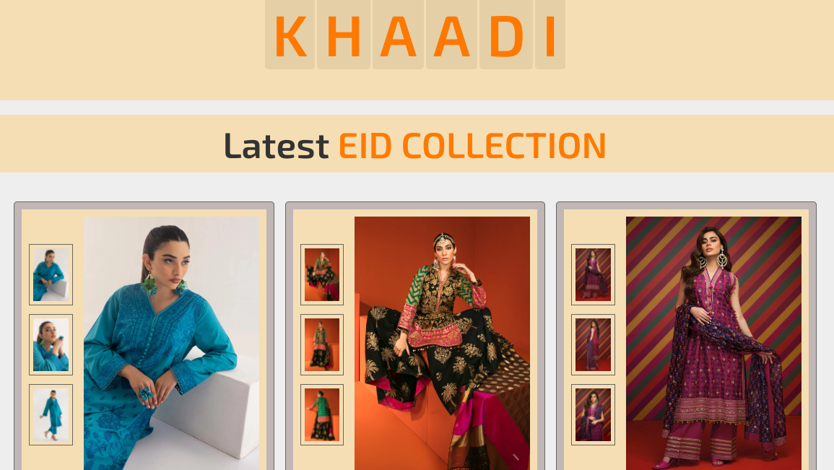
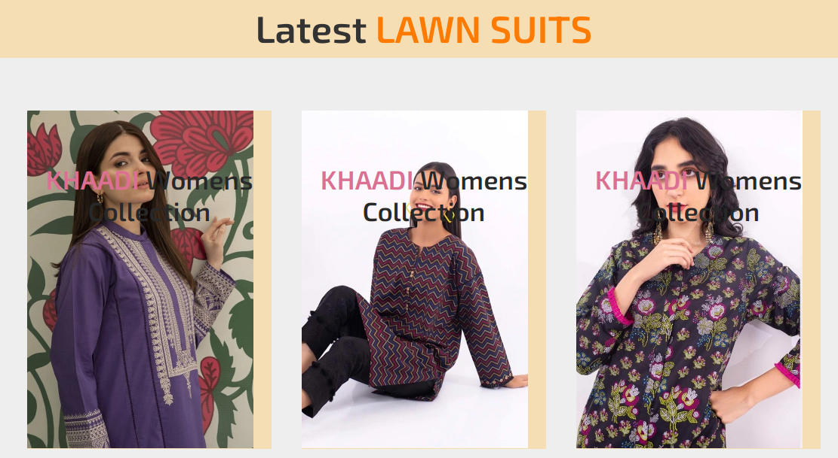
KHAADI MEN COLLECTION
KHAADI LATEST COLLECTION
KHAADI WOMEN COLLECTION

Slide 15
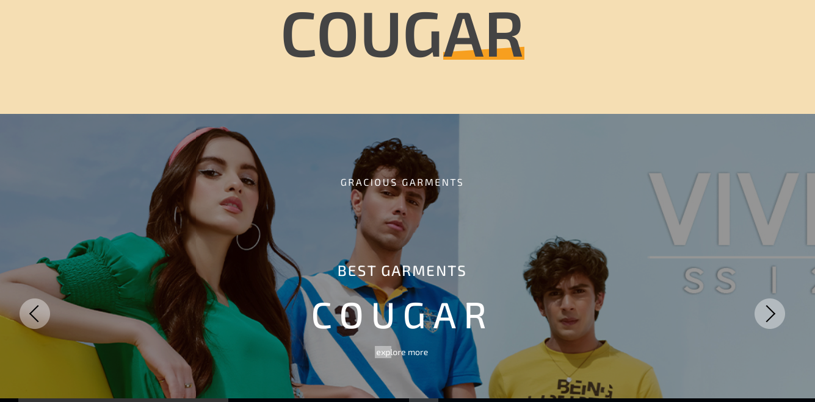
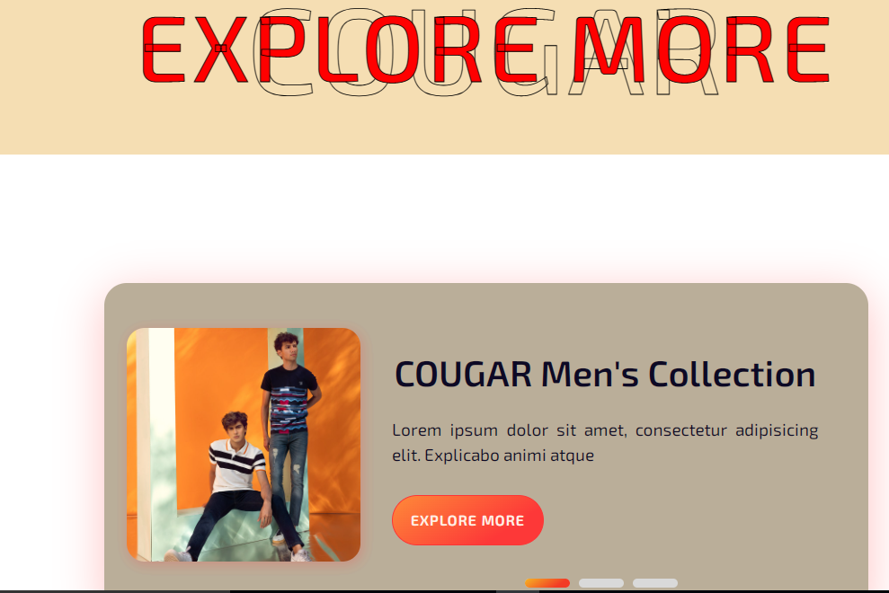
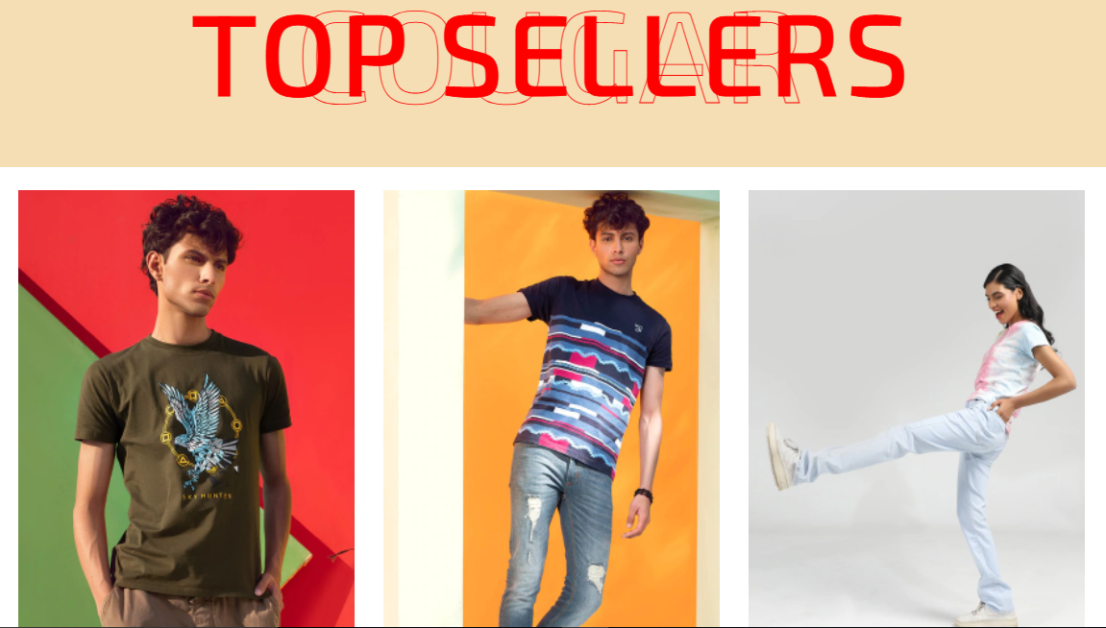
GRACIOUS GARMENTS COUGAR( 3rd Brand of our site)

Slide 16
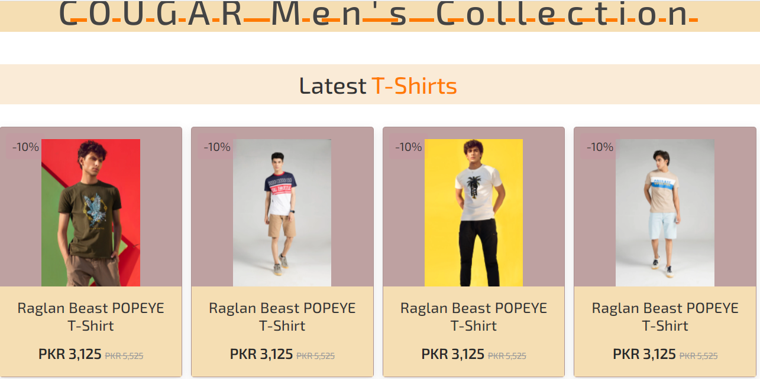
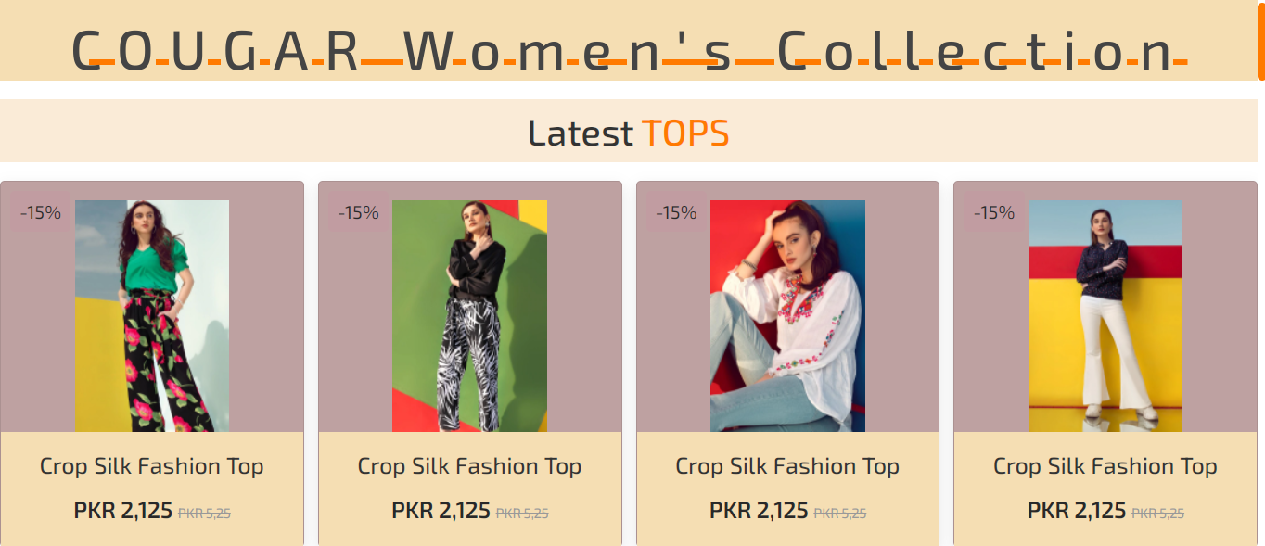
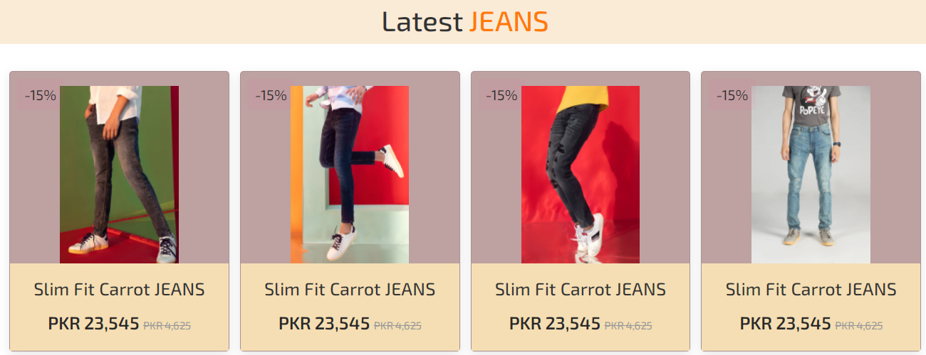
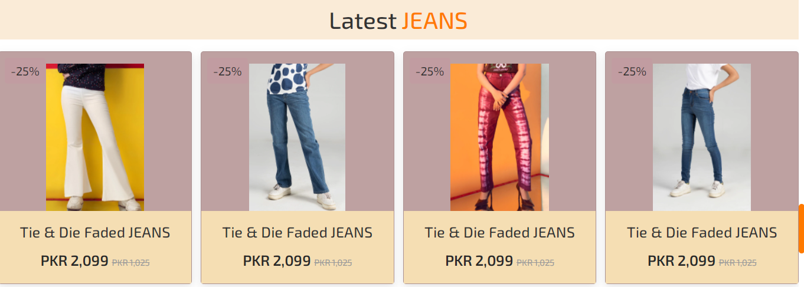
COUGAR MEN COLLECTIONS
COUGAR WOMEN COLLECTIONS

Slide 17
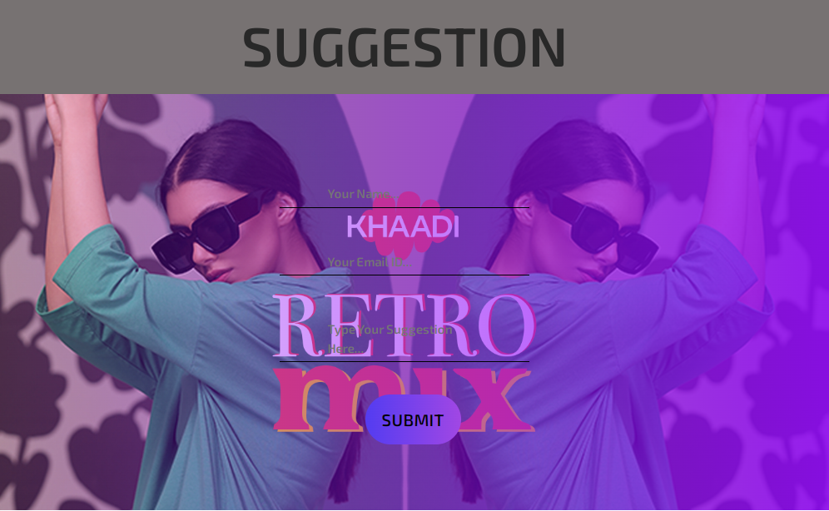
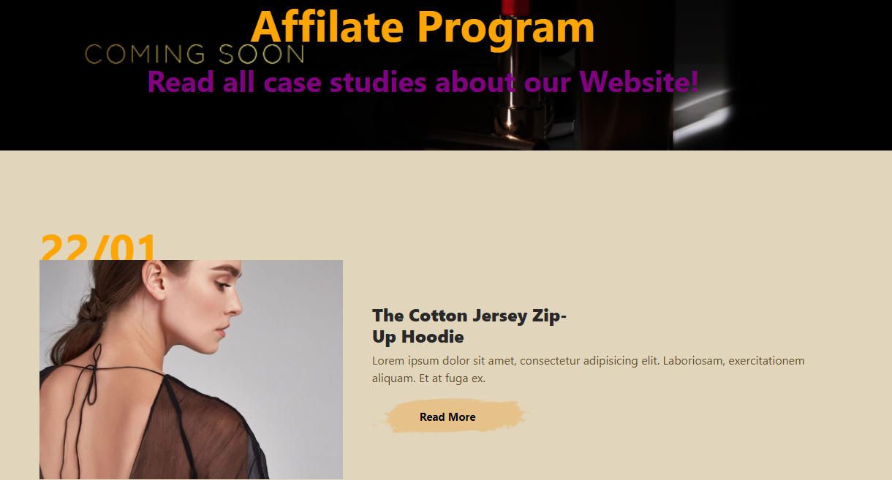
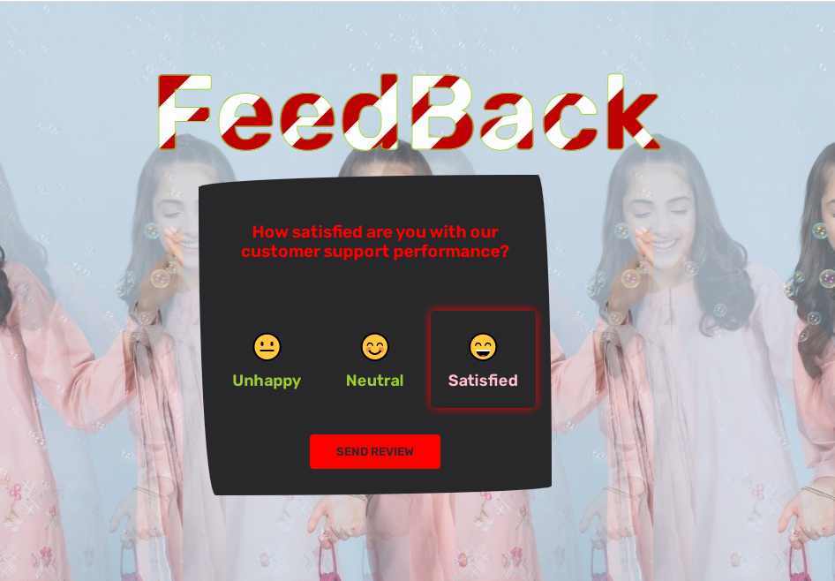
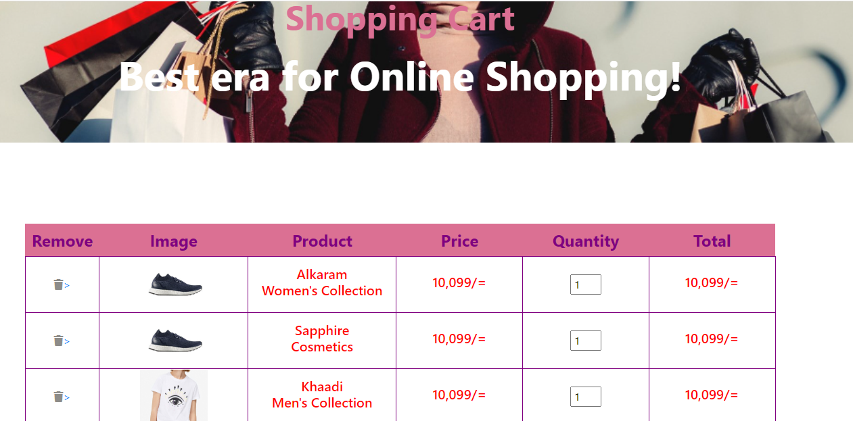

Slide 18
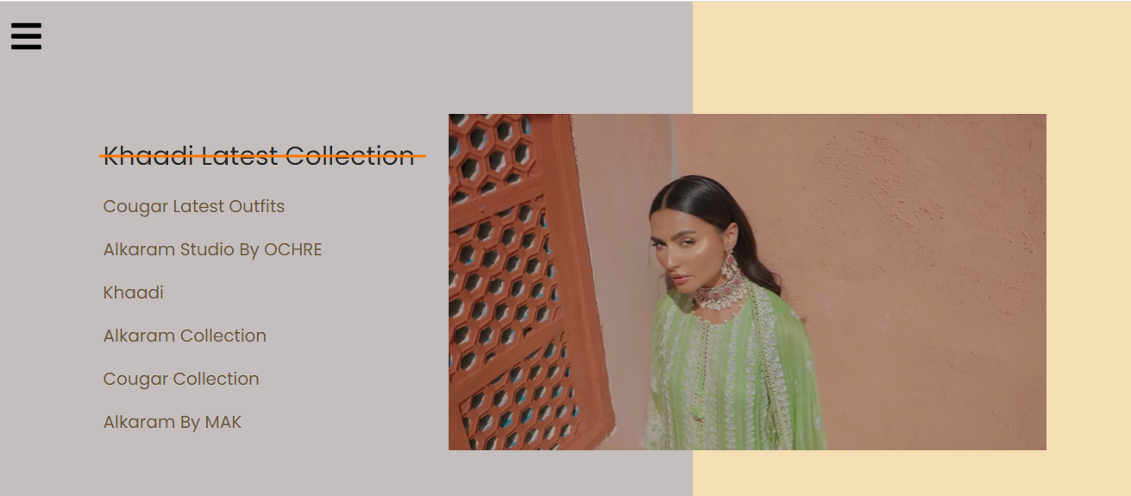
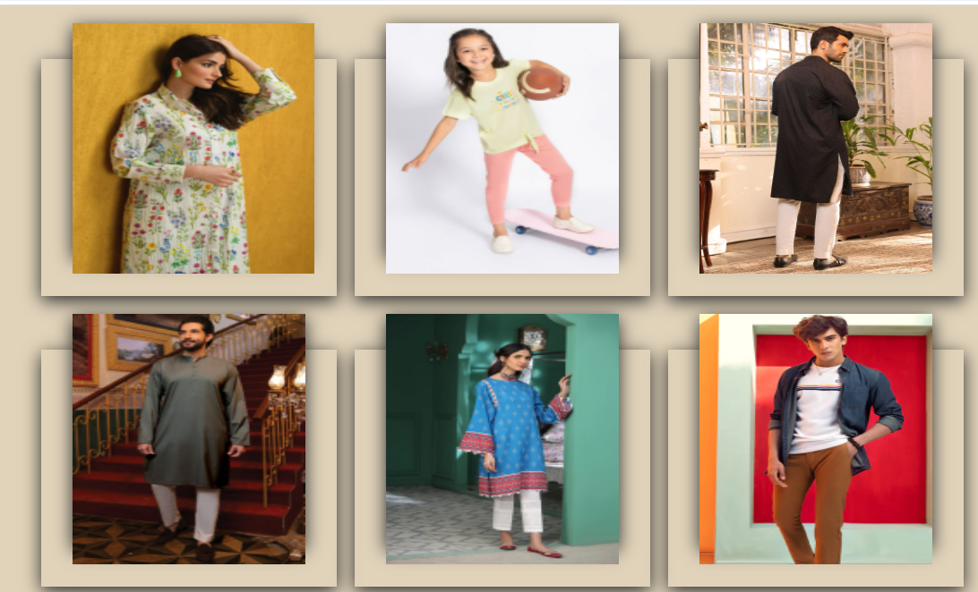
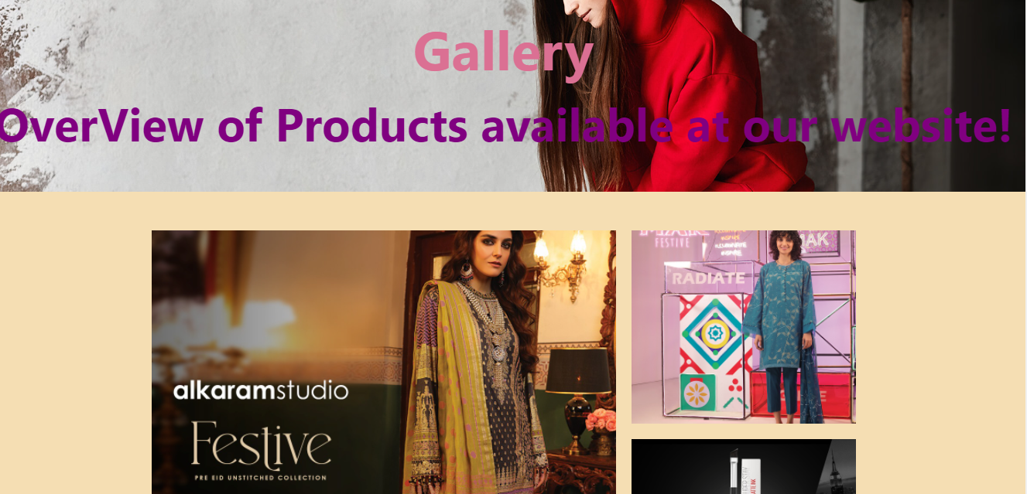

Slide 19
THANK YOU!
“Fashion is like eating, you shouldn’t stick to the same menu.”

